Slide 1
Hate speech online Freedom of expression, incitement, anonymity online & liability for intermediaries
17 October 2013, Sarajevo, BiH
Website: www.article19.org Twitter: @article19law
Email: andrew@article19.org;

Slide 2
1. “Hate” speech?
[A]ll forms of expression which spread, incite, promote or justify racial hatred, xenophobia, anti-Semitism or other forms of hatred based on intolerance, including intolerance expressed by aggressive nationalism and ethnocentrism, discrimination and hostility towards minorities, migrants and people of immigrant origin
Council of Europe, Committee of Ministers Recommendation 1997

Slide 3
2. Positive policy measures
Civil society/national institutions - reporting, monitoring and challenging all forms of prejudice – more speech!
Comprehensive freedom of expression and anti-discrimination legislation and implementation
Building institutional knowledge
Public education and information campaigns
Responsibilities of public officials and mobilisation of influential actors and institutional alliances
Role of an independent, pluralistic, and self-regulated media abiding by ethical standards.

Slide 4
3. Limiting freedom of expression
Article 19(3) of the ICCPR requires limitations on freedom of expression to be:
Provided by law;
In pursuit of a legitimate aim
The rights and reputations of others
Public order, national security, public health and morals
Necessary in a democratic society (meeting a “pressing social need”)

Slide 5
4. The obligation to prohibit “incitement”
ICCPR Article 20(2): “Any advocacy of national, racial or religious hatred that constitutes incitement to discrimination, hostility or violence shall be prohibited by law.”
Requires states to prohibit

Slide 6
5. Six part threshold test
Context: of the expression in broader societal context of the speech.
Position and role of the speaker: in a position of authority and exercising that authority.
Intent: of the speaker to incite to discrimination, hostility or violence;
Content: form and subject matter of expression, tone and style.
Extent of the expression: public nature of the expression; the means of the dissemination; magnitude of the expression;
Likelihood of harm, including imminence: probability of discrimination, hostility or violence as a result of the expression.

Slide 7
6. Anonymity online
Anonymity online is a right.
Systems of prior registration are a prior restraint on expression and should be avoided.
Real-name requirements don’t work.
ISPs, including internet portals, should protect the anonymity of their users unless a judicial order tells them otherwise

Slide 8
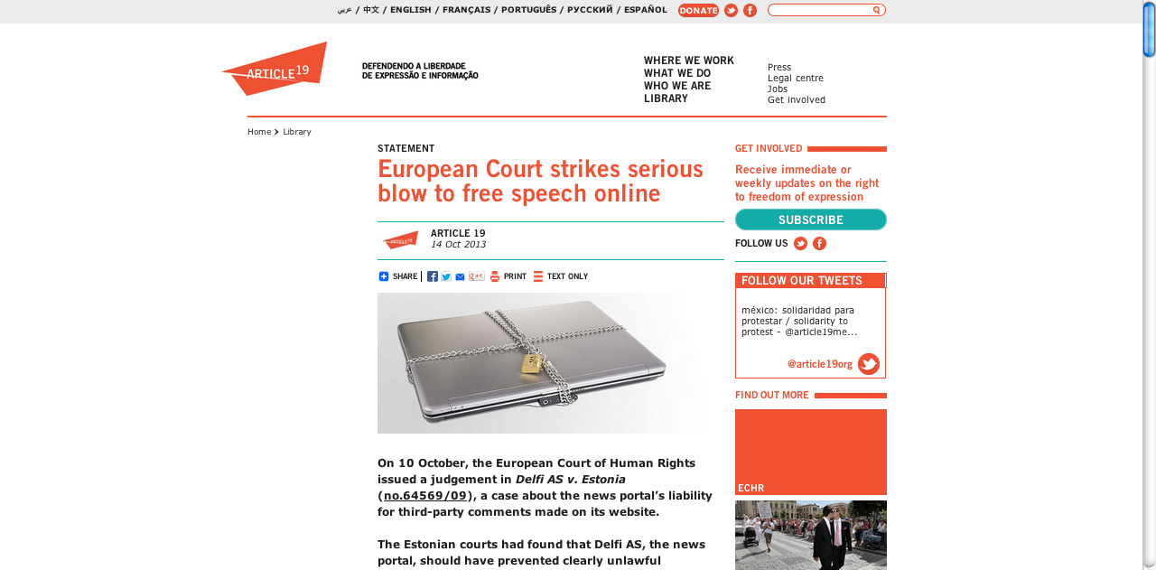
7. Intermediary liability

Slide 9
Thank you
Email: andrew@article19.org
Twitter: @article19law

